Slide 1

ASP .NET MVC core
overview on project

Slide 2
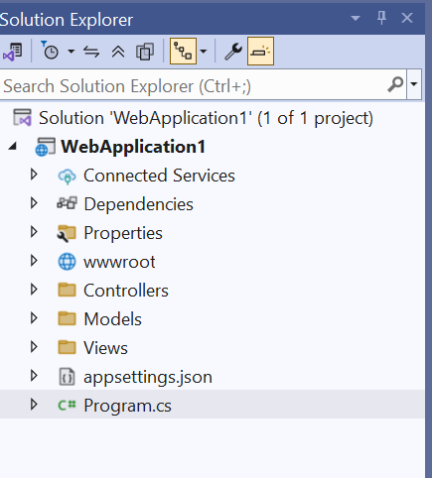
Project : By default, the project content 3 main folder
Model
View
conteroller
In addition, many configuration files.

Slide 3
1. Program.cs
It configures the web host and services, sets up dependency injection (DI), configures middleware, and initializes the application.
You can define environment-specific settings, logging, services, and more here.
Key points:
builder.Services: Where you add services to the application’s DI container (e.g., MVC, Entity Framework, etc.).
app.UseRouting(), app.UseEndpoints(), etc.: Set up middleware and routing.
app.MapControllerRoute(): Defines routing for MVC controllers.
Notes:
Middleware processes requests and responses.
Routing maps requests to specific endpoints.

Slide 4
2. appsettings.json
used to store configuration settings in a key-value format.
Stores settings like connection strings, logging configuration, application-specific settings, etc.
Supports JSON format, typically used for production and development environments.
Key points:
ConnectionStrings: Holds database connection strings.
Logging: Configures logging behavior.
AllowedHosts: Restricts the allowed hostnames from accessing the application (helpful for security).

Slide 5
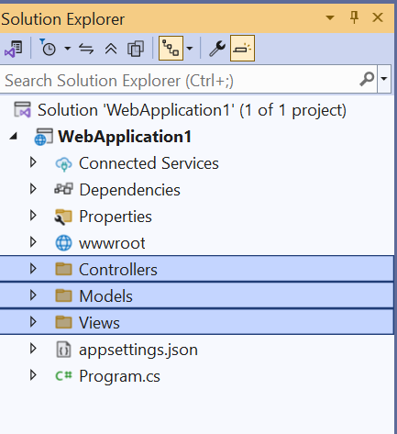
The 3-Folder MVC
In the Model-View-Controller (MVC) pattern, the view handles the app's data presentation and user interaction. A view is an HTML template with embedded Razor markup.
Razor markup is code that interacts with HTML markup to produce a webpage that's sent to the client.

Slide 6
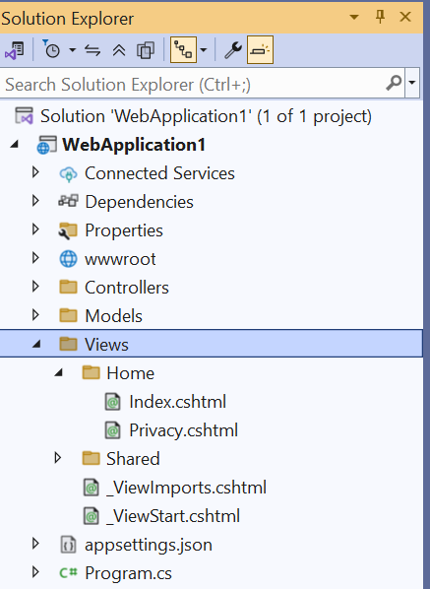
view
In ASP.NET Core MVC, views are .cshtml files that use the C# programming language in Razor markup. Usually, view files are grouped into folders named for each of the app's controllers. The folders are stored in a Views folder at the root of the app:
The Home controller is represented by a Home folder inside the Views folder. The Home folder contains the views for the Privacy and Index (homepage) webpages.
When a user requests one of these tow web pages, controller actions in the Home controller determine which of the three views is used to build and return a webpage to the user.

Slide 7
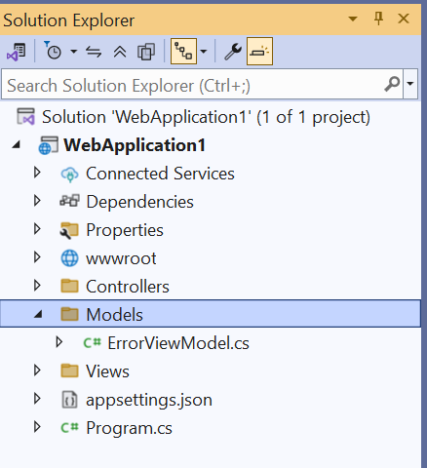
model
These model classes are used with Entity Framework Core (EF Core) to work with a database. EF Core is an object-relational mapping (ORM) framework that simplifies the data access code that you have to write.
The model classes created are POCO classes, from Plain Old CLR Objects. POCO classes don't have any dependency on EF Core. They only define the properties of the data to be stored in the database.
In this tutorial, model classes are created first, and EF Core creates the database.

Slide 8
Controller
Controllers: Classes that:
Handle browser requests.
Retrieve model data.
Call view templates that return a response.

Slide 9
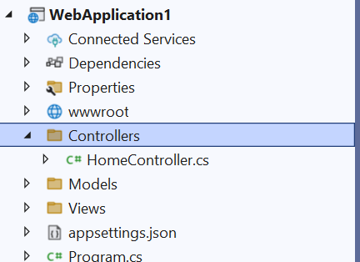
Controller
In an MVC app, the view only displays information. The controller handles and responds to user input and interaction. For example, the controller handles URL segments and query-string values and passes these values to the model. The model might use these values to query the database. For example:
https://localhost:7263/Home/Privacy: specifies the Home controller and the Privacy action.

Slide 10
wwwroot folder
Static files, such as HTML, CSS, images, and JavaScript, are assets an ASP.NET Core app serves directly to clients by default.
Static files are accessible via a path relative to the web root. For example, the Web Application project templates contain several folders within the wwwroot folder:
wwwroot
css
js
lib

Slide 11
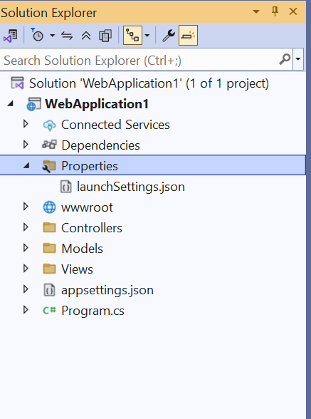
Properties folder
The properties folder contains a launchSettings.json file, which contains all the information required to launch the application. Configuration details about what action to perform when the application is executed and contains details like IIS settings, application URLs, authentication, SSL port details, etc.

Slide 12
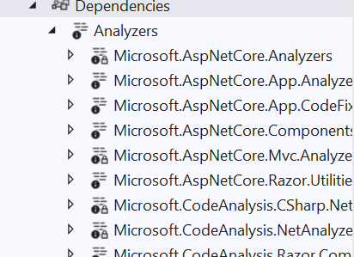
Dependencies
The Dependencies node contains all the references of the packages used in the project. Here the Frameworks node contains reference two most important dotnet core runtime and asp.net core runtime libraries.

Slide 13
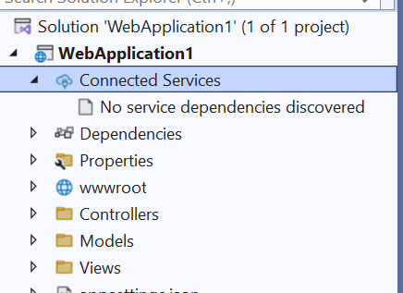
Connected Services
It contains the details about all the service references added to the project. A new service can be added here, for example, if you want to add access to Cloud Storage of Azure Storage you can add the service here

Slide 14
Implementation - Controller
This is the part responsible for processing requests and giving responses.
It is represented as a class.
This class is inherited from a parent class called Controller.
Any new controller must be added inside the controller folder.
It should be named as class name + controller.
It contains inside it a set of functions called actions.
There must be a separate folder with the name of this controller inside the View folder.

Slide 15
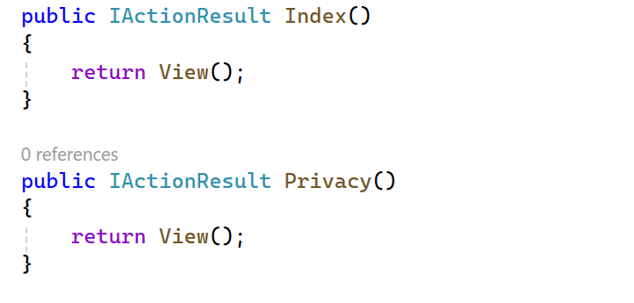
Implementation - Controller
Action Methods:
Action must be public
Action can not be overloaded
Action can not be static method

Slide 16
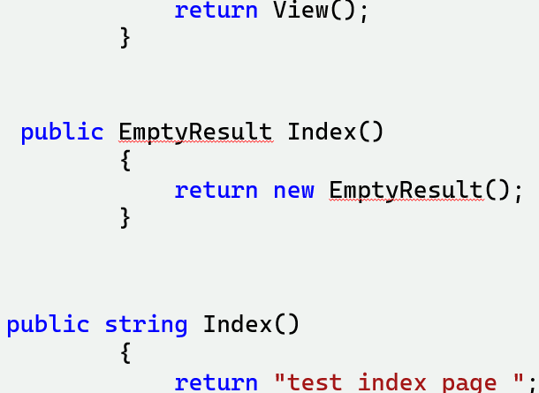
Implementation - Controller
Return data types:
ActionResult → is a general class
ViewResult → return View();
EmptyResult → return new EmptyResult();
ViewResult is a subclass of ActionResult

Slide 17
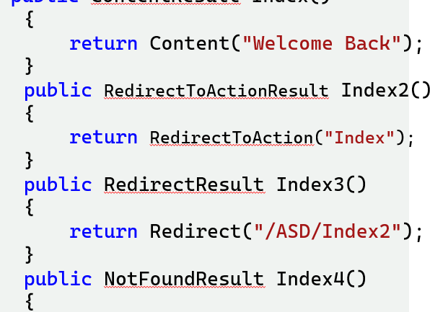
Implementation - Controller
Return data types:
RedirectResult → return View();
NotFoundResult
RedirectToAction
String
Int
…

Slide 18
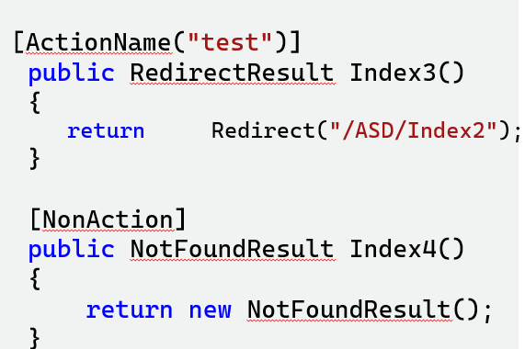
Implementation - Controller
Action Selectors: it helps routing engine to select right action.
[ActionName(“xyz”)] -> It has priority in execution.
[NonAction] -> routing engine Treats it like it's private.

Slide 19
Implementation - Controller
Action Verbs:
[HttpGet] -> Send data from controller to view.
[HttpPost] -> Send data from view to controller.
[HttpDelete]
[HttpHead]
[HttpPatch]
[HttpPut]

Slide 20
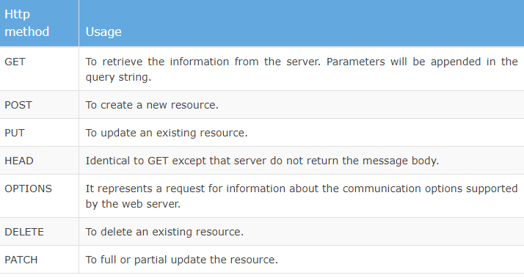

Slide 21
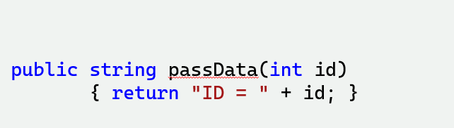
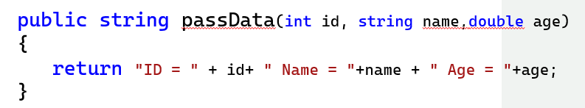
Implementation - Controller
Pass Data through Url:
https://localhost:7183/ C_name /passData/55
https://localhost:7183/C_name/passData? id=99 & name=glaal &age=55

